Slide 1
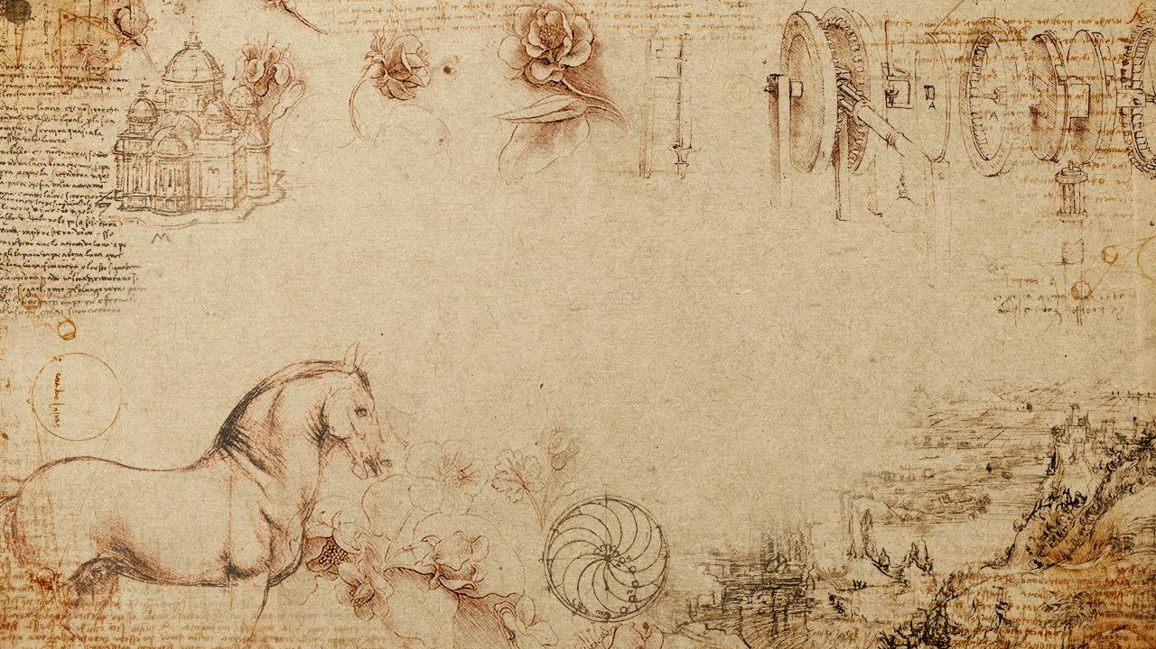
Analysis on Britain’s Early Modern Social Network
- Team 6 -
Josh Chen
Alex Lu
Mira Stefanova
Andy You

Slide 2
Research objectives
What characterizes Britain’s social network in the 15th – 18th century?
How do there global network-level characteristics differ for sub-groups?
What impact do major events, such as the death of a monarch or a marriage, have on the network dynamic?
What are some of the predictors of a person’s length of life within this network?

Slide 3
Agenda
1.
Data exploration and preparation
2.
Evolution of the network over time
3.
Centrality and other network characteristics
4.
Subgroup-level differences
5.
Network impact of major events
6.
Life expectancy predictors

Slide 4

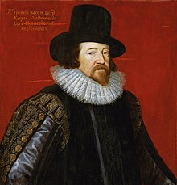
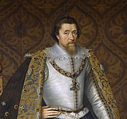
Data Exploration
Six Degrees of Francis Bacon is a dataset of Britain’s early modern social network
Francis Bacon
Discovery
People: 15801
Edges: 171409
Female Ratio: 20%
Avg. years of relation: 42.5
Avg. length of life: 69.2
Year range: 1389 – 1722
Relationship Type: Met
Start year: 1587
End year: 1625
Confidence: 71
{
Prefix: King
Suffix: VI and I
Birth year: 1566
Death year: 1625
Gender: Male
Historical significance: King of Scotland, England, and Ireland
James IV and I

Slide 5
Data Preparation
Deleted values with confidence < 20 and abnormal entries
Identified Kings and Queens with sufficient network data by historical significance
11 Kings, 20 Queens
Grouped individuals by social
status through filtering suffix, title,
and historical significance
Status/Title | %
No title | 70.9
Regular (Doctor) | 13.9
Religious | 13.8
Titled (Duke) | 0.9
Royal | 0.5

Slide 6
Data preparation moving forward
Further classify the
societal role of individuals
Status/Title | %
No title | 70.9
Regular (Doctor) | 13.9
Religious | 13.8
Titled (Duke) | 0.9
Royal | 0.5

Slide 7
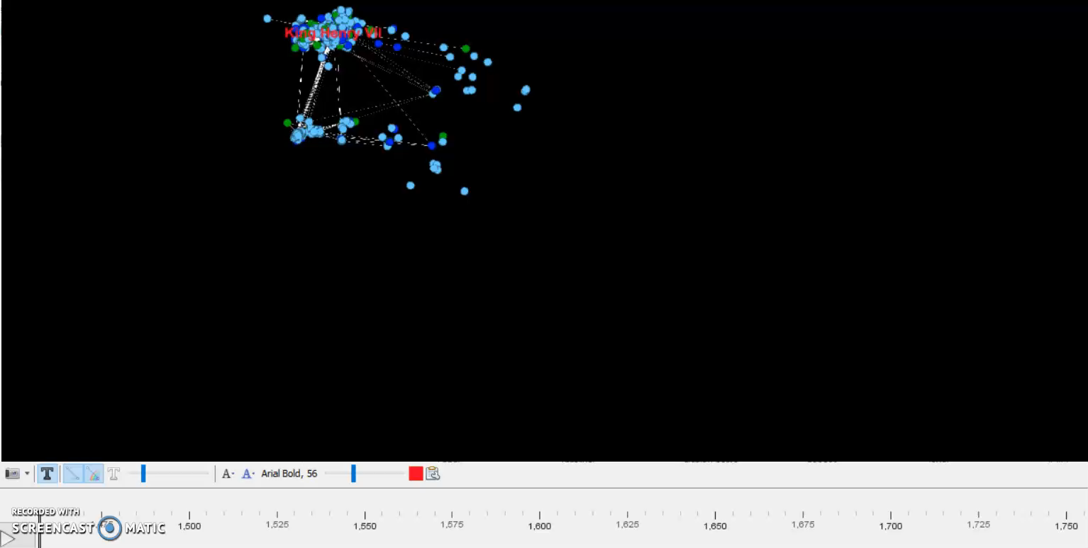

Evolution of the Social Network over time

Slide 8
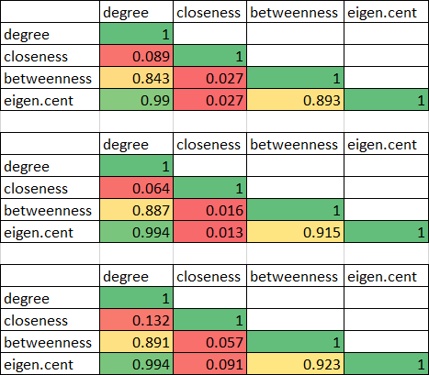
Evolution of the correlation between centrality measures
1500
1600
1700

Slide 9
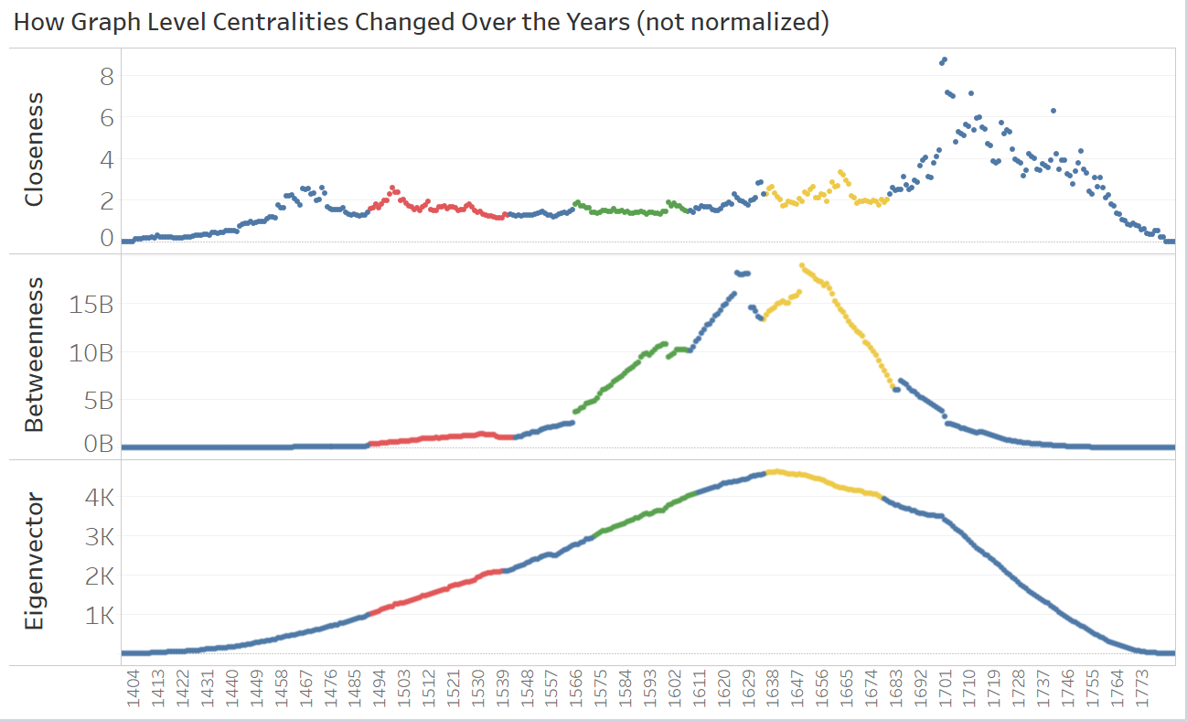
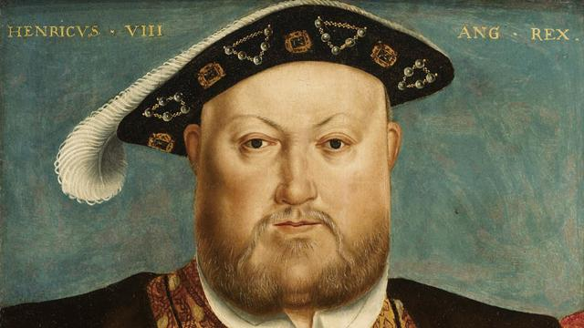
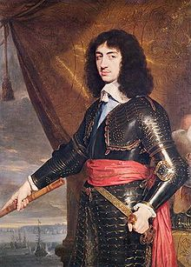
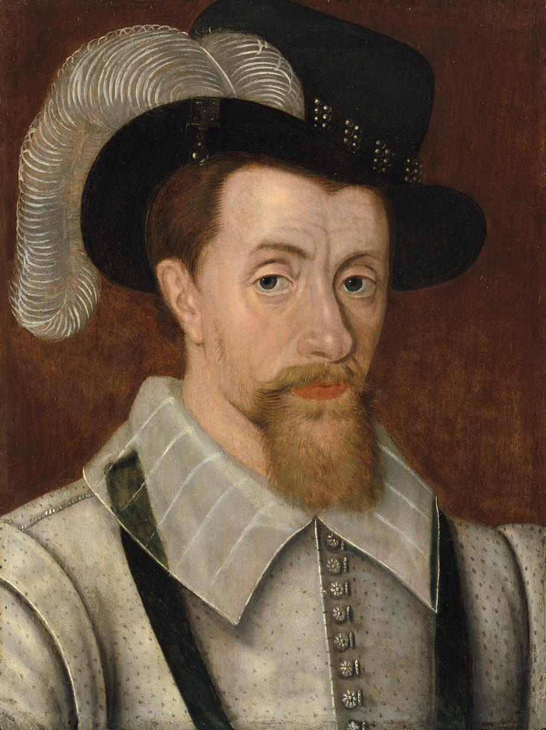
Network centralities over the years

Slide 10
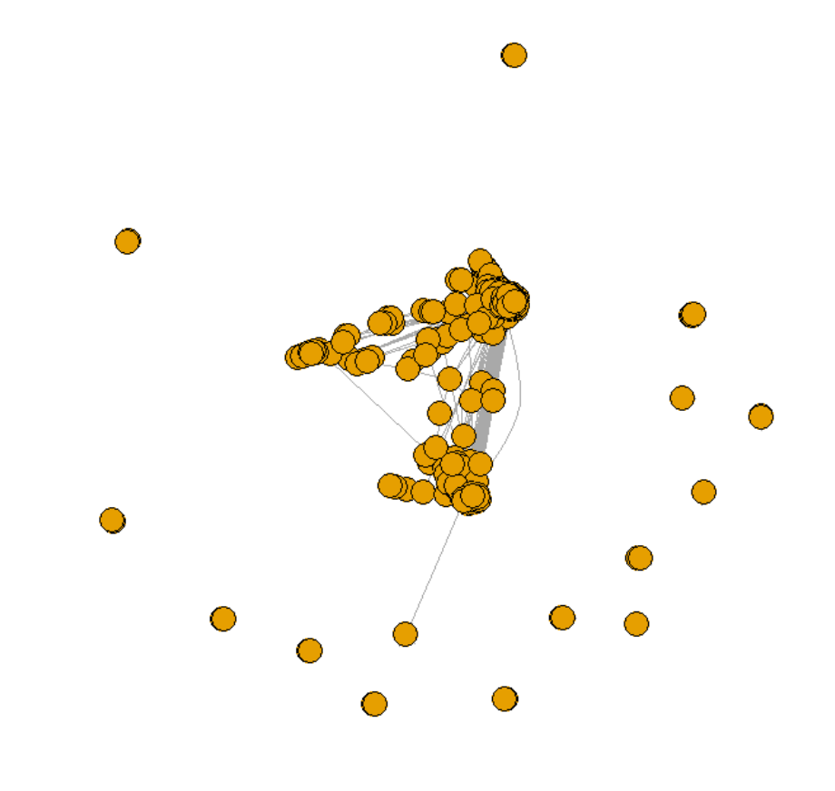
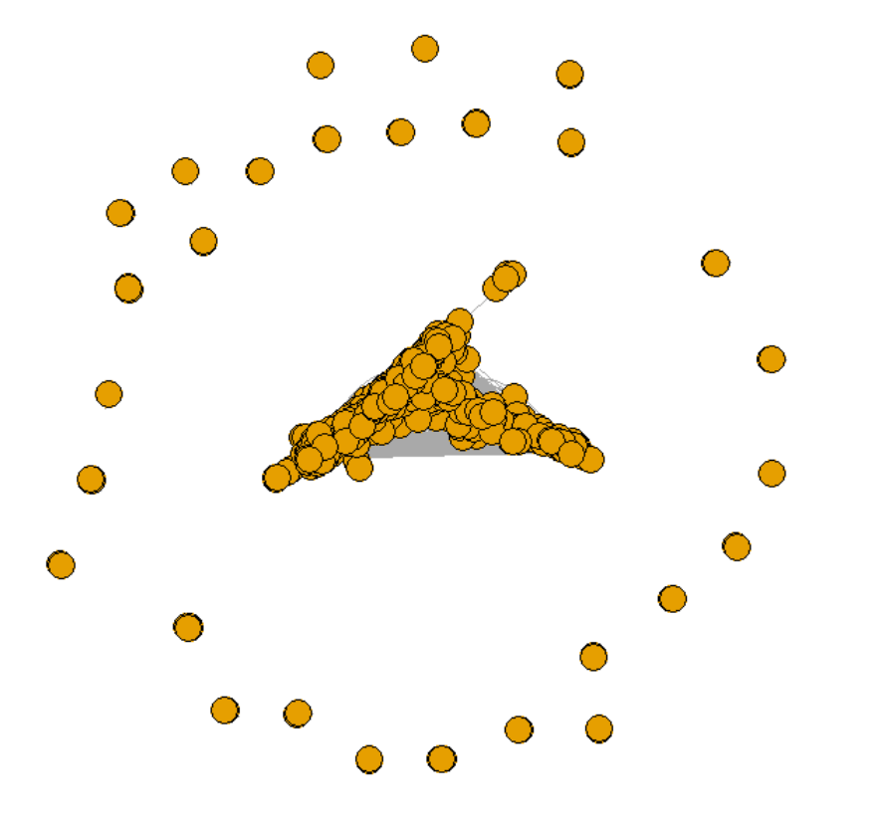
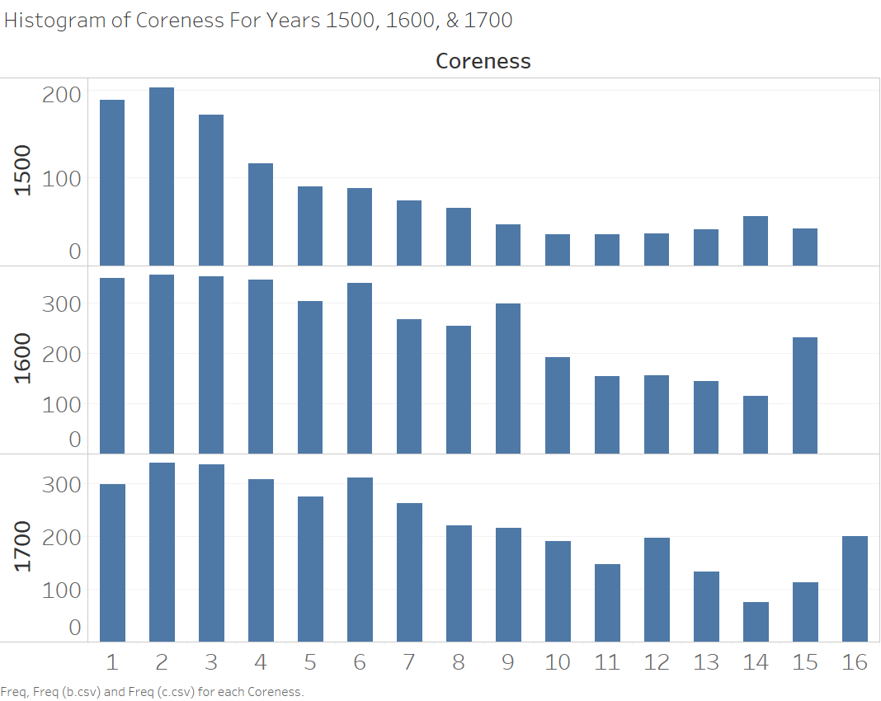
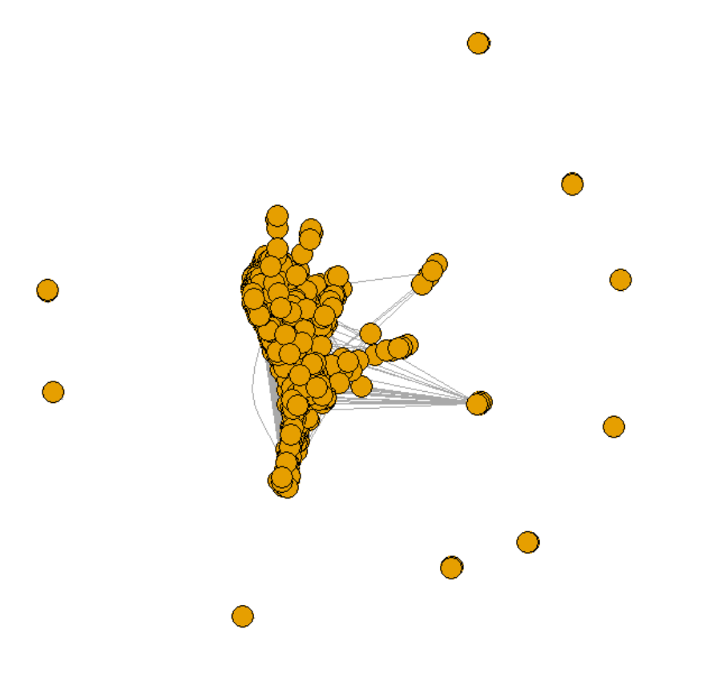
Highest Degree K-Core for Years 1500, 1600, 1700

Slide 11
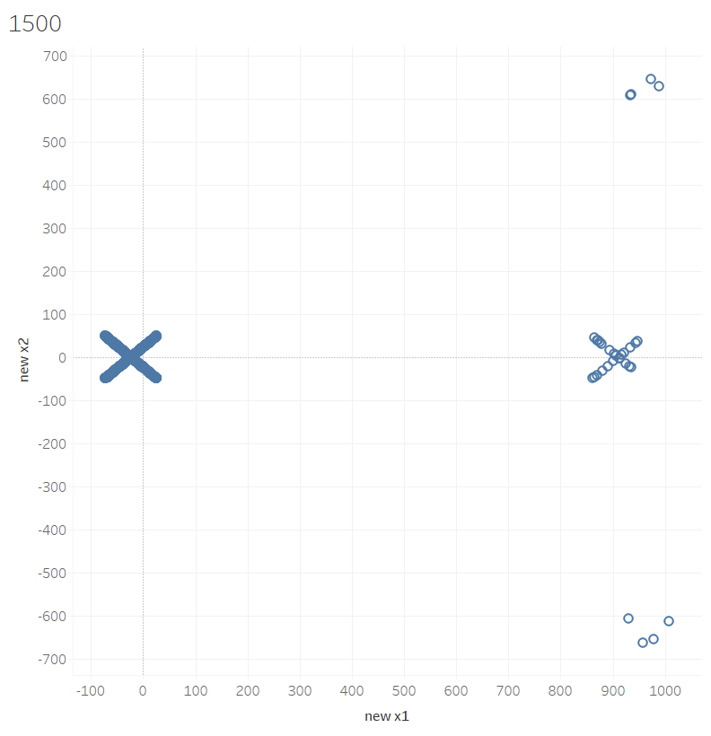
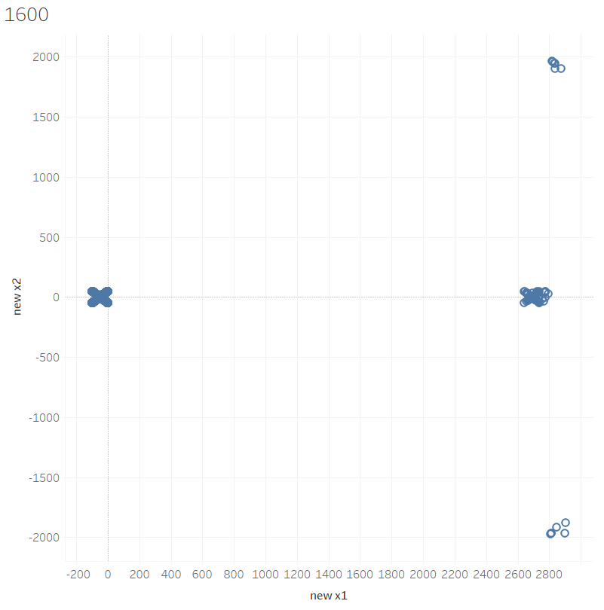
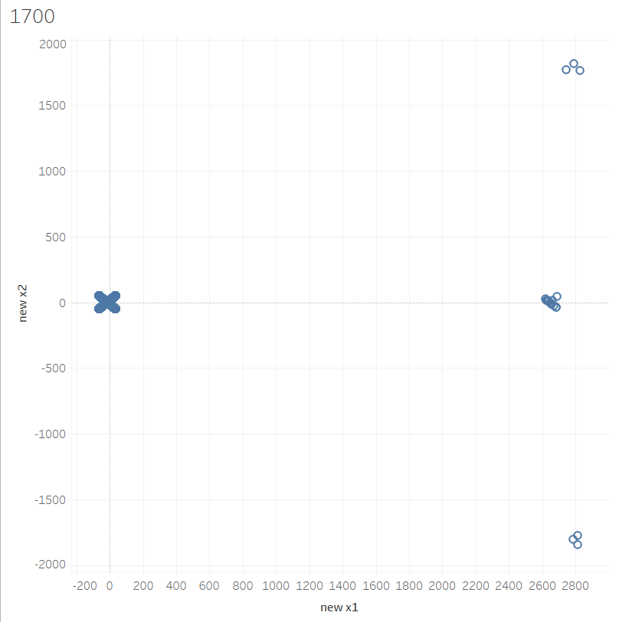
Multidimensional Scaling Based on Centralities
Clearly visible core with 3 small clusters on the periphery

Slide 12
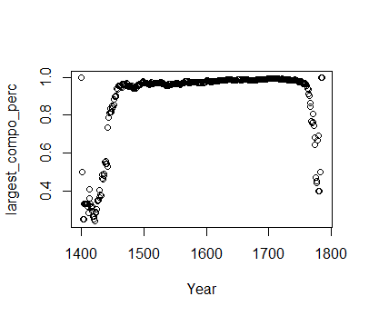
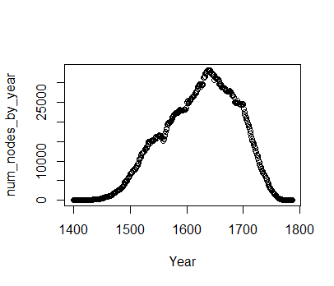
Over 90% of the network members belong to the core
Number of relationships that existed in the data in each year.
First and last 50 years lack sufficient data.
The percentage of people who belong to the largest component of the graph.

Slide 13
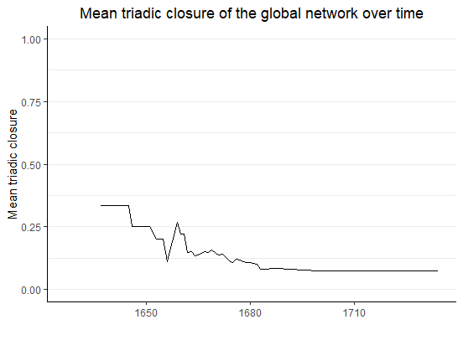
The network exhibits low triadic closure over time
Complex network with low interconnectivity
May suffer from instability when negative relationships occur
Potential for structural gaps and natural development of many new connections

Slide 14
Network characteristics, moving forward
Evaluate whether network exhibits homophily base on gender and based on social class
Simulate likelihood of this network structure compared to random chance
Expected findings:
Clear homophily based on both gender and social class
Proof that the tie formation within this network is not independent

Slide 15
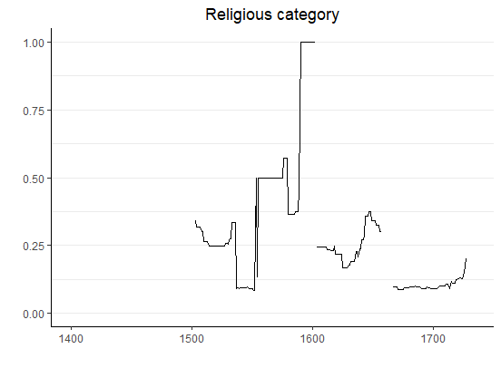
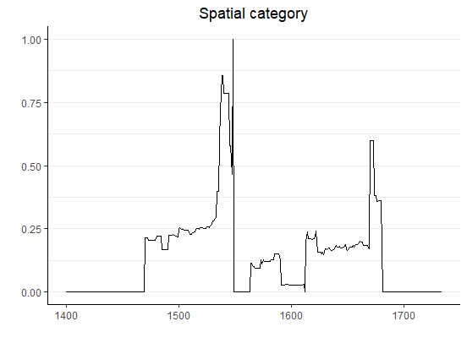
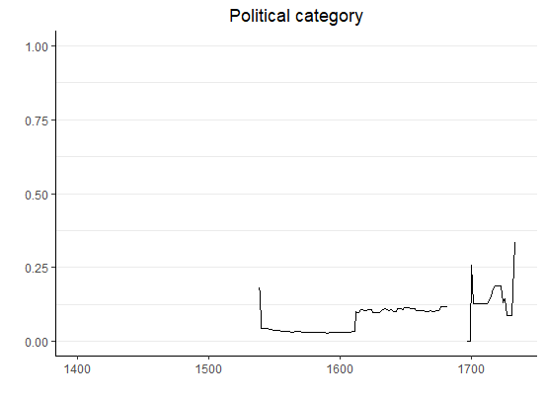
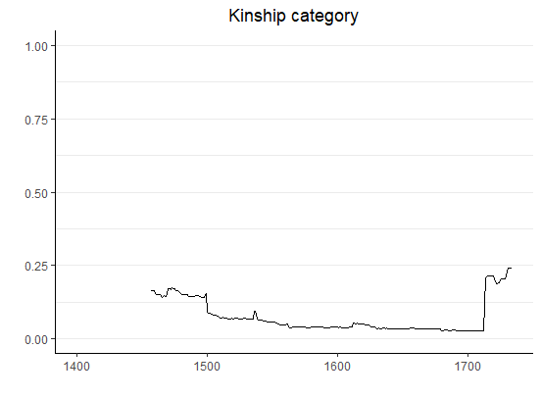
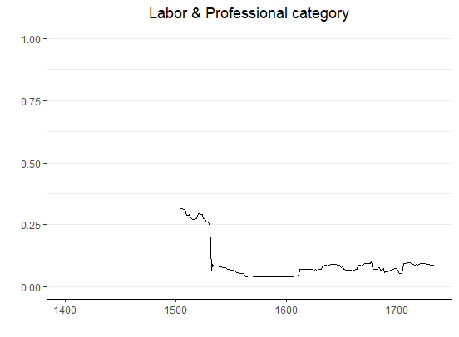
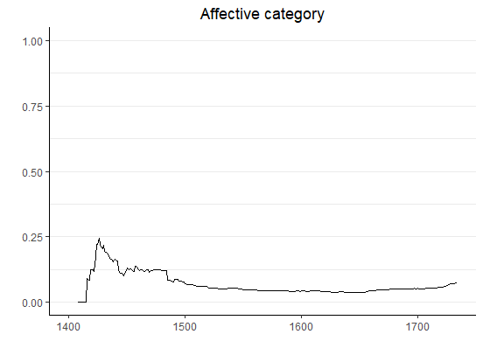
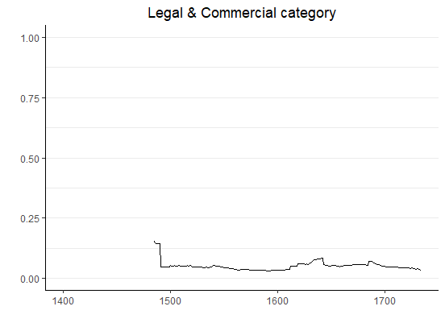
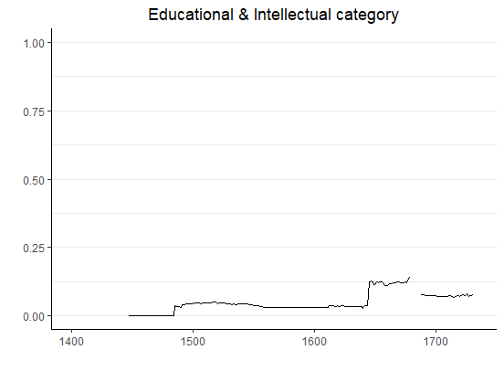
Mean triadic closure varies based on the type of relationship between people
8 sub-networks of all members with a certain connection type and their 1st degree connections
Mean closure
Mean closure

Slide 16
Expectedly high closure levels of religious and special connections
High triadic closure in community-focused categories
Mean closure
Mean closure

Slide 17
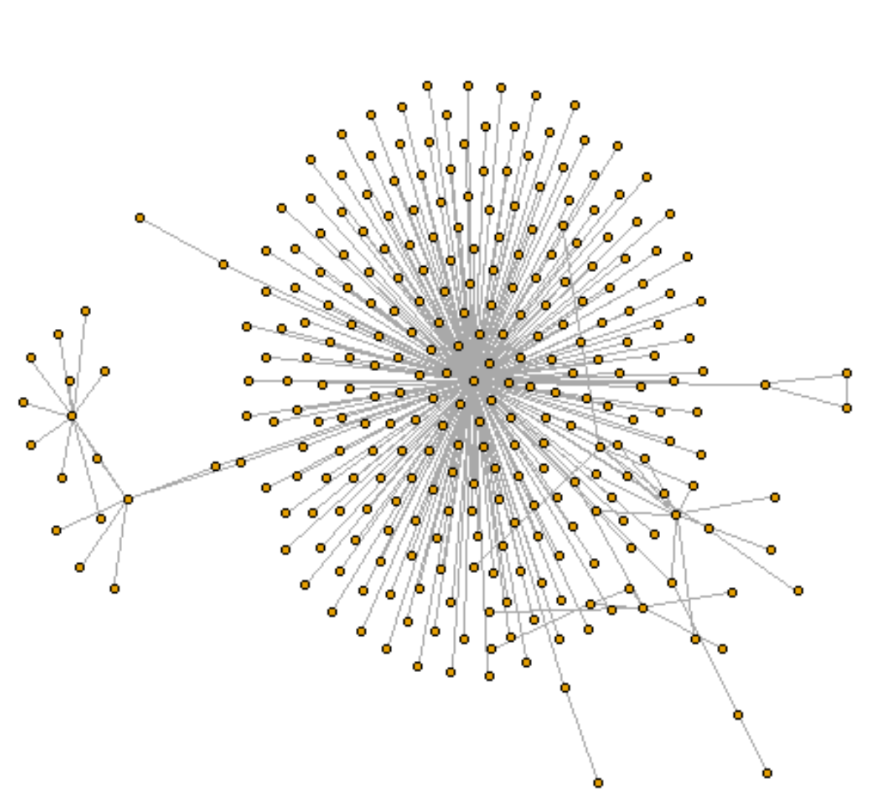
Unexpectedly low closure level of kinship connections
Friends of friends never introduced?
1st decree connections not historically important?
Mean closure

Slide 18
Subgroup-level differences, moving forward
Analyse further to discover the “Why” of certain subgroup differences
Evaluate network characteristic of male vs. female networks
Explore network differences across social circles
Expected findings:
Female network better at closing triads
Male network has higher degree core
Social circle sub-networks significantly different

Slide 19
Shift in Network Dynamic - Death of King/Queen
Motivation
King/Queen are most influential individuals in the network
Their death changes the network of the royal families and affiliated individuals dramatically
Approach
Filter connections 5 years before and after a king/queen’s death
Identify neighbor of each king/queen and compute their ecntralities
Use the first year as the base centrality measure to calculate change

Slide 20
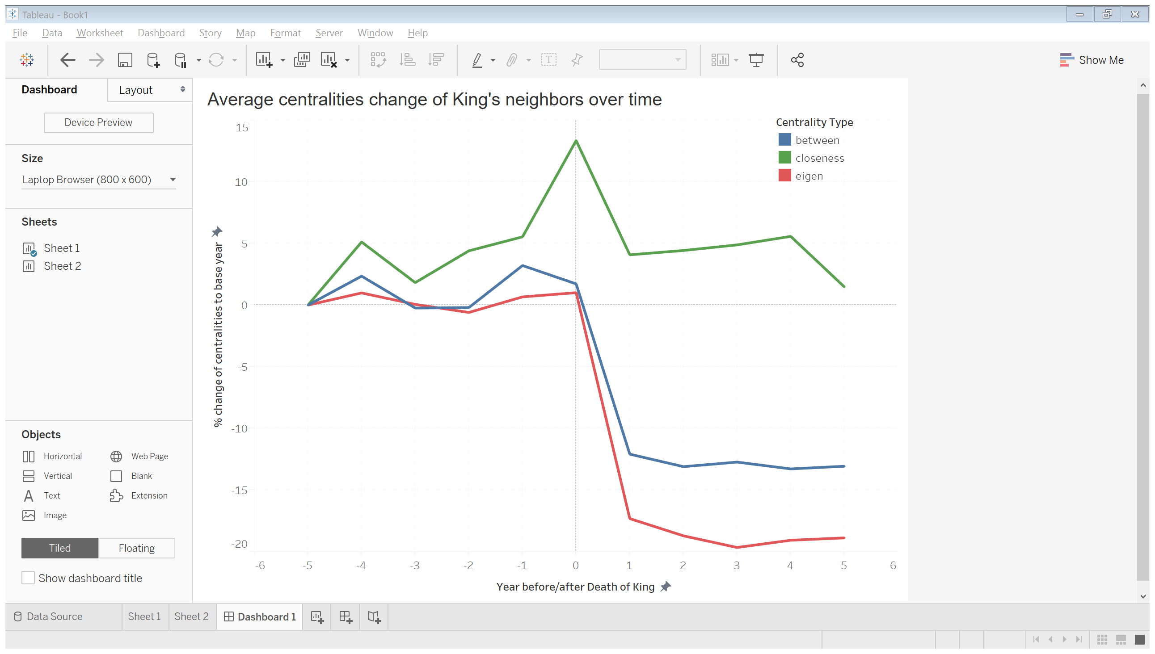
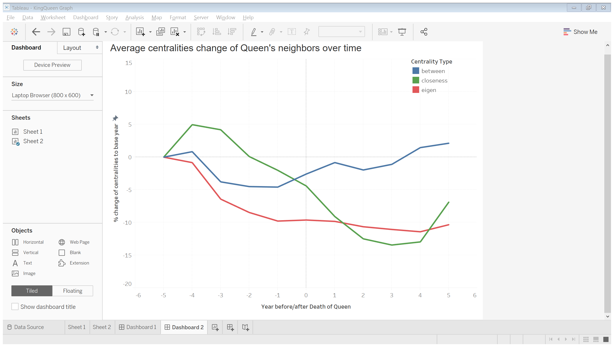
Shift in Network Dynamic - Death of King/Queen
King
Queen
The network impact of a king’s death is significantly greater than that of a queen
Closeness and eigenvector centralities drop significantly after the death of king and show no signs of recovering within 5 years

Slide 21
Impact of major events, moving forward
Differentiate the analysis based on the different type of death of monarch:
- unexpected death of active monarch
- expected death of active monarch
- death of monarch who stepped down from power more than 1 year before death
Analyse the network dynamic effect of marriage
Evaluate network effects beyond the 1st degree connections

Slide 22
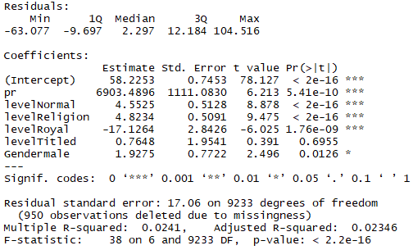
Regression Analysis on Life Expectancy
$$life length=page rank+factor\left(social status\right) +factor(gender)$$
Individuals with certain titles lived longer than those without any title.
Royal members lived much shorter than other people - might because by unnatural death in war.

Slide 23
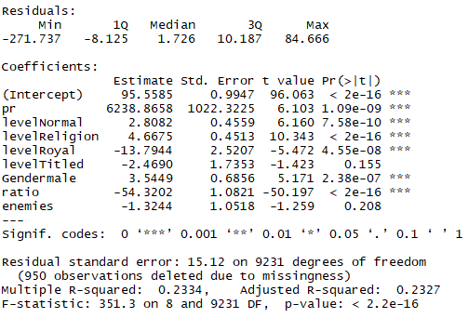
Regression Analysis on Life Expectancy
$$life length=page rank+factor\left(social status\right) +factor\left(gender\right)$$
$$+ ratio+enemy$$
Added the number of enemies and the ratio of mean relationship length of each individual to its life length
The ratio has a significant negative estimate.

Slide 24
Life expectancy predictors, moving forward
Develop and evaluate additional predictors:
- Social circle(s) the individual belongs to
- Number of different social circles an individual is 1st degree connected to.
Expected findings:
Positive correlation of number of different social circles one is connected to
A few social circles having significant impact on life expectancy

Slide 25
Thanks!
Any questions?

